Slide 1
SERGIO and EUNICE FUSTERO: Our collaborators: info@fustero.net

Slide 2
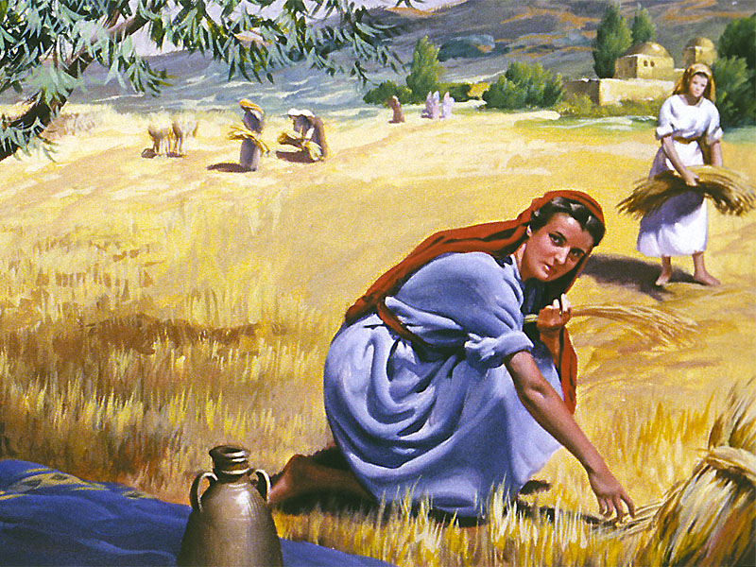
The Harvest and the Harvesters
Lección 12

Slide 3
Memory Text: “Herein is my Father glorified, that ye bear much fruit; so shall ye be my disciples”
(John 15:8).
Read for This Week’s Study: John 1:40–46, 4:28–30, Luke 24:47–53, Acts 1:6–8, Matt. 9:36–38, Luke 15.

Slide 4
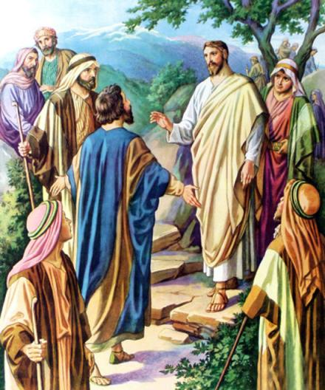
In many respects this week’s study is a continuation of the previous lesson. Christ established spiritual leaders for the distinct purpose of proclaiming the kingdom of God. The principles and methodology that Jesus employed must remain the spiritual foundation for the Christian’s preparation today.
In other words, modern leadership development theories must never supplant the foundation that Christ Himself laid. Whenever hype and publicity take precedence over spiritual growth, the results are shallowness and spiritual sterility.

Slide 5
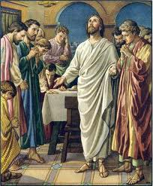
Whenever proselytizing displaces repentance, conversion, and spiritual transformation, the mission falters. Training leaders to conduct membership drives, media blitzes, and public relations campaigns instead of preparing them for spiritual warfare is courting disaster. True evangelism and disciple-making are centered around (1) the acknowledgment of our sinfulness, (2) genuine heartfelt contrition, (3) our unreserved spiritual surrender, and (4) the irrepressible compulsion to disseminate God’s divine message to others.

Slide 6
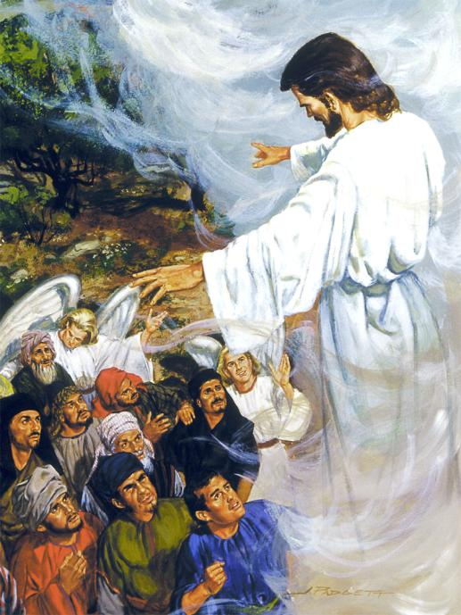
1. Beggars’ Bread
Nearing His earthly departure, Christ’s concern focused upon His disciples, whom He had selflessly served and deeply loved. They would not be abandoned. Although Jesus Himself had to return to heaven, the Holy Spirit was commissioned to supply the spiritual intimacy that the disciples had enjoyed in His presence. Christ’s instruction regarding the Spirit’s work was so valuable that John devotes several chapters to its preservation.

Slide 7
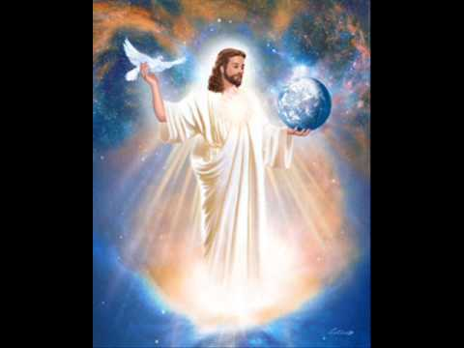
One defining element was the Spirit’s testimony concerning Christ, even though the Spirit would not testify unaided. Accompanied by the Spirit, Christ’s disciples would likewise testify concerning Jesus’ ministry. God could have commissioned angels, unassisted by human beings, to broadcast the gospel. Instead, He elected to appoint sinful, erring, unpredictable humans for this sacred calling.

Slide 8
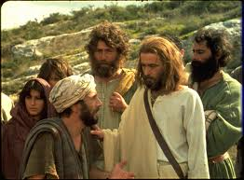
Read John 1:40–46; 4:28–30; 15:26, 27; 19:35, 36. What do these texts teach us about the ways in which the human and divine work together in the winning of souls?
Evangelism has been defined as “beggars telling other beggars where to find bread.” Andrew certainly excelled here. The writings of his brother Peter were to be included in Scripture one day, Peter’s ministry was chronicled in Acts, and Christ included Peter among His three closest associates. Those honors never attended Andrew. Nevertheless, he received special recognition for following Christ’s simple instruction to lead people to Jesus.

Slide 9
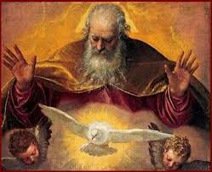
2. When Jesus Urged Patience
Read Luke 24:47–53, Acts 1:6–8, 16:6–10. Why was waiting for the Spirit necessary? What was the Spirit’s role in the evangelistic outreach of the primitive church? What encouragement might modern believers draw from Paul’s experience when facing frustration? What lessons regarding patience and waiting for God’s timing are suggested within these passages?

Slide 10
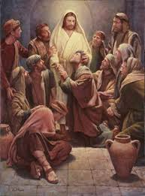
Through discourse and example,
Jesus taught His disciples
patience. Facing bigotry,
ignorance, misunderstanding,
and outright conspiracy, Christ
nonetheless patiently
persevered.
Such perseverance was anchored by Christ’s complete dependence upon God’s divine Spirit. Jesus understood that unless these disciples should likewise experience this dependence, the kingdom’s advancement was seriously jeopardized. Conversely, should they learn this lesson at the outset, their future ministry would be destined for heavenly attainments. Therefore, His departing command was “Wait.”

Slide 11
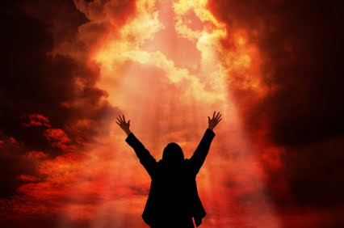
Christ desires that modern believers master that lesson also. Well-intentioned but self-confident Christians, when unwilling to patiently await the Spirit’s guidance, can embarrass themselves and God’s kingdom.

Slide 12
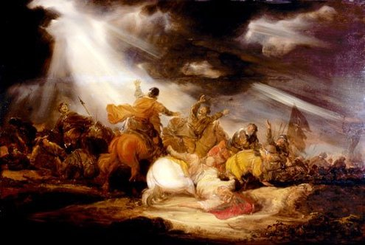
The apostle Paul drafted ambitious plans for entering Bithynia; but even headstrong Paul was sensitive to God’s leading and accepted rather than resisted the Spirit’s interference. The apostle willingly received the Spirit’s directive that sent him to Macedonia instead. Numerous miracles attended his efforts there. Had Paul rushed headlong with his designs, the European mission might have stalled indefinitely.

Slide 13
REFLECTION
How can our anxious spirits be calmed to await patiently for the Spirit’s leading? What practical things should modern believers do in their attempts to cultivate such patience? What does patient, prayerful trust indicate regarding our relationship with God?

Slide 14
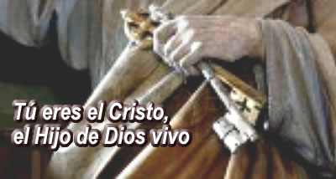
3. Exercising Authority
Compare the following passages: Mark 6:7–13, Matthew 16:14–19, 18:17–20, 28:18–20, John 20:21–23. What do these verses tell us about the kind of authority that Jesus’ disciples had? What does this mean for us today?
“Peter had expressed the truth which is the foundation of the church’s faith, and Jesus now honored him as the representative of the whole body of believers. He said, ‘I will give unto thee the keys of the kingdom of hea-ven: and whatsoever thou shalt bind on earth shall be bound in heaven: and whatsoever thou shalt loose on earth shall be loosed in heaven.’

Slide 15
“ ‘The keys of the kingdom of heaven’ are the words of Christ. All the words of Holy Scripture are His, and are here included. These words have power to open and to shut heaven. They declare the conditions upon which men are received or rejected. Thus the work of those who preach God’s word is a savor of life unto life or of death unto death. Theirs is a mission weighted with eternal results.”—Ellen G. White, The Desire of Ages, pp. 413, 414.

Slide 16
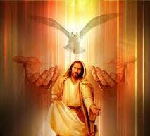
As the Father commissioned
Jesus, so Christ commissions
His disciples. Through the S
pirit, the Father invested
Christ with divine power.
Through the Spirit, Jesus
likewise invests His disciples
with divine power commen-
surate with their earthly
assignments. No follower
should fear that Christ has
shortchanged them. Every
necessary skill, talent, capa-
bility, and strength has been
supplied.

Slide 17
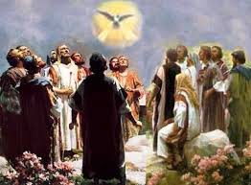
Sometimes human leadership fails to recognize the principles involved. Whenever leaders assign tasks without extending commensurate power, failure is predictable. Often leaders’ insecurities surface through controlling behaviors that subjugate the thoughts, God-ordained creativity, and individuality of others. Thus emasculated, the subjugated disciple fails to be effective. Such behavior would look like a conductor attempting to play every instrument simultaneously instead of conducting a symphony.

Slide 18
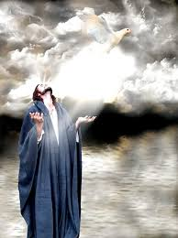
Jesus’ example speaks volumes here. If anyone ever possessed the right to withhold authority and dictate behavior, Christ certainly did. Instead, He invested others with authority, commissioned them to labor outside of His presence where His only influence would be His instruction and examples and sent them to minister and witness.

Slide 19
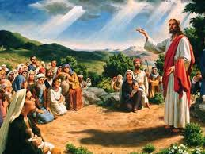
4. Laborers for the Harvest
“But when he saw the multitudes, he was moved with compassion on them, because they fainted, and were scattered abroad, as sheep having no shepherd. Then saith he unto his disciples, The harvest truly is plenteous, but the labourers are few; Pray ye therefore the Lord of the harvest, that he will send forth labourers into his harvest” (Matt. 9:36–38). What important message can we take from these verses for ourselves, today, and for the task ahead of us?

Slide 20
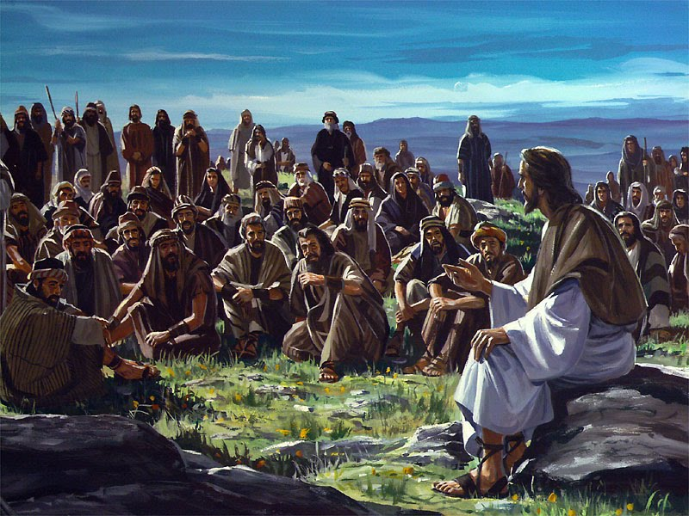
The spiritual harvest overflowed, but harvesters were scarce. The heart soil had been prepared, the spiritual seed had been planted; germination, plentiful moisture, and abundant sunshine spurred unbelievable growth. Ripened souls awaited harvesting, but where were the harvesters? Utilizing simple, easily understood word-pictures, Jesus sought to inspire contagious zeal.

Slide 21
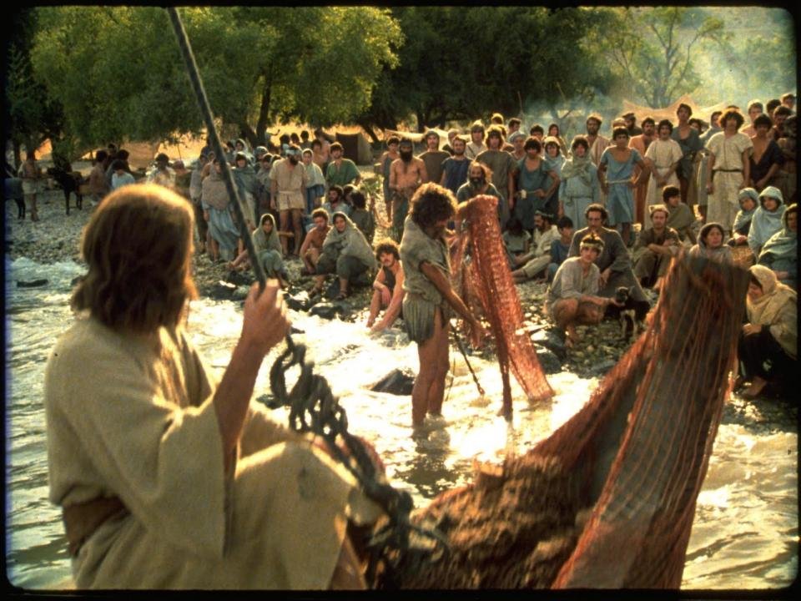
Sometimes Christians covet their fellowship with other believers and cluster together, blindly bypassing worldly seekers who are ripened for harvest. Perhaps not realizing their divine accountability for perishing souls, they busy themselves with church engagements, civic responsibilities, building maintenance, and other worthwhile projects dedicated to preserving the status quo.

Slide 22
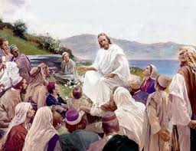
These are doubtless good things. Well-intentioned members sometimes question the value of evangelism or express this sentiment: “Pastor, this evangelism stuff is all right, but don’t we need programs for people who are already in church?”
This is a fair enough question, though one must also ask, “When did Jesus ever lament the shortage of grain preservers?” Instead, “more harvesters” was His prayerful plea.

Slide 23
REFLECTION
How can we find the right balance between ministering to the needs of those in the church and at the same time not neglecting outreach?

Slide 24
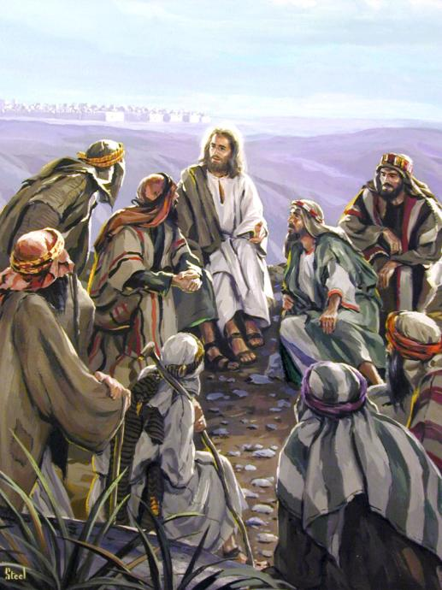
5. Lost and Found
Through teaching and personal example, Jesus taught His disciples to associate with sinners, even notorious ones such as prostitutes and tax collectors. How else would they disciple the whole world? His teaching often focused on these sinners. His characterization of them as “lost” demonstrates how merciful Christ was. He might have characterized them as “rebellious” (they certainly were) or “depraved.” Instead, He chose “lost.”

Slide 25
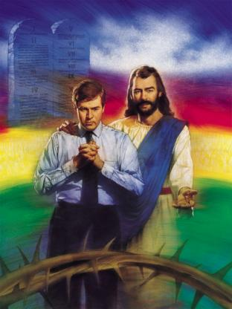
Lost doesn’t carry the same negative connotations that are contained in those other words. Rather than castigating fallen souls, we should follow Christ’s example. Lost is a generous description, because the responsibility is placed upon the finders. Disparaging remarks drive lost people away. Neutral language conveys acceptance and the possibility for relationship. We therefore must be careful not only about the language we speak, but even about the words we think, because our thoughts will greatly impact our attitudes toward others.

Slide 26
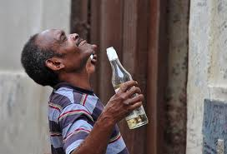
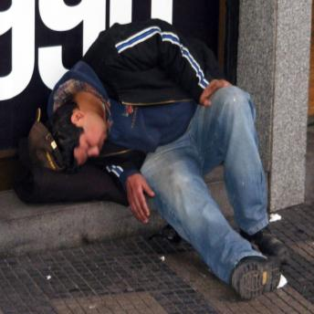
Throughout the Gospels, Jesus encourages believers to become finders. He wants us to love and to reach out to the lost, regardless of the kind of people they are or the kind of lives they live.

Slide 27
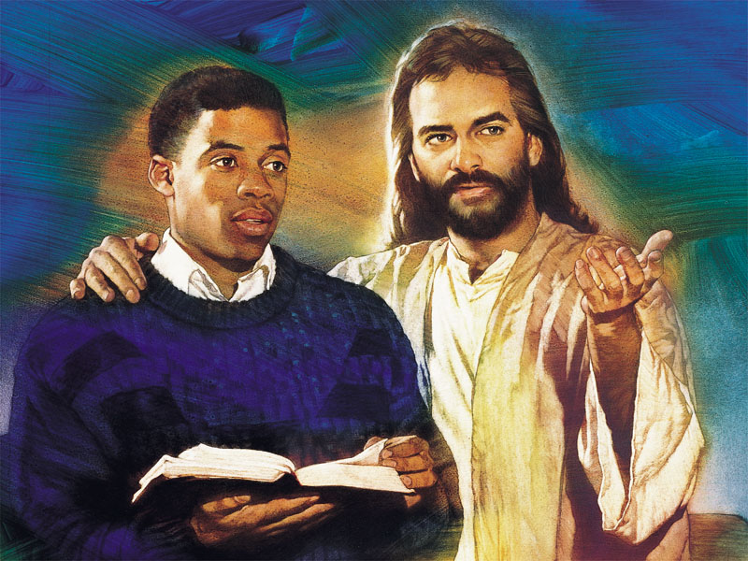
“This is the service that God has chosen—‘to loose the bands of wickedness, to undo the heavy burdens, and to let the oppressed go free, and that ye break every yoke, . . . and that thou hide not thyself from thine own flesh.’ Isa. 58:6, 7. When you see yourselves as sinners saved only by the love of your heavenly Father, you will have tender pity for others who are suffering in sin. You will no longer meet misery and repentance with jealousy and censure. When the ice of selfishness is melted from your hearts, you will be in sympathy with God, and will share His joy in the saving of the lost.” —Ellen G. White, Christ’s Object Lessons, pp. 210, 211.

Slide 28
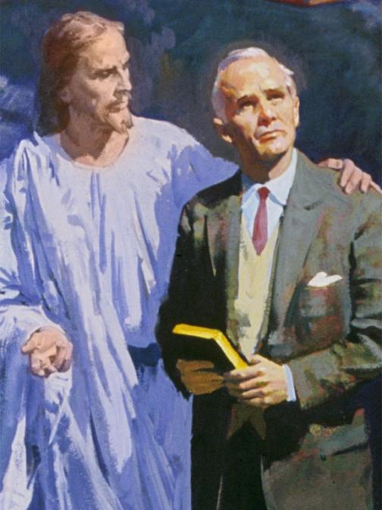
Study Luke 15. What essential message comes through in all these parables? What should this message say to us about the way in which God views the lost and what our responsibility to them is

Slide 29
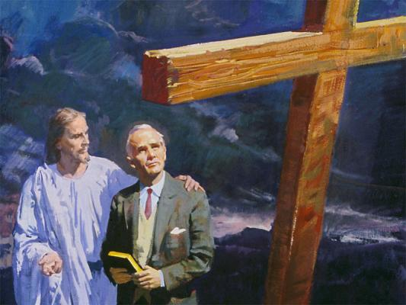
Further Study: Read Ellen G. White, “The Last Journey From Galilee,” pp. 488–496; “Who Is the Greatest?” pp. 436–440, in The Desire of Ages; “The Training of the Twelve,” pp. 17–24; “The Great Commission,” pp. 25–34; “Pentecost,” pp. 35–46; “The Gift of the Spirit,” pp. 47–56, in The Acts of the Apostles.
“The disciples felt their spiritual need and cried to the Lord for the holy unction that was to fit them for the work of soul saving. They did not ask for a blessing for themselves merely. They were weighted with the burden of the salvation of souls. They realized that the gospel was to be carried to the world, and they claimed the power that Christ had promised.”—Ellen G. White, The Acts of the Apostles, p. 37.

